Slide 1
Applying Model Checking to Generate Model-Based Integration Tests from Choreography Models
Oprea Laurentiu-Cristian
Raducanu Andrei-Cosmin
Stancu Denisa-Georgiana
Voinea Stefania-Alexandra

Slide 2
Introduction

Slide 3
In this paper, the authors introduce a model-based integration testing (MBIT) approach for testing service choreographies, which are used to describe communication protocols between services in service-based systems.
To achieve this, the authors propose a service choreography modeling approach called Message Choreography Models (MCM), which are translated into Event-B models for test generation using the ProB model checker.

Slide 4
The paper explores the practical application of MBT and formal methods in an industrial context and outlines the MCM syntax and related test generation approaches.
The contributions of this work include a new approach to testing service choreographies and practical considerations for its implementation.

Slide 5
Background and
Related Work

Slide 6
Background
Service choreography models are essential for ensuring quality in service-based systems, particularly in the context of service-oriented architectures (SOA). They provide a means of describing communication protocols between services and can support several software quality-related development methods, including design, verification, and testing. However, existing choreography languages like WS-CDL and BPMN often fall short in fulfilling all these requirements simultaneously.
In response, SAP Research developed Message Choreography Modeling (MCM) to address these limitations.

Slide 7
The paper presents a model-based testing (MBT) approach for service integration testing using MCMs. As MCMs are based on communicating extended finite state machine (EFSM) semantics, the paper explains that constraint solving techniques must be applied for automatic test generation.
The models are translated to Event-B, which can be processed by the model checker ProB to generate test suites for service integration that cover all communication protocol transitions while minimizing the effort required for test concretization and execution. CSP process algebra expressions, synchronized with the Event-B models, are used to encode concurrent aspects of the test case generation algorithm.

Slide 8
Related Work
The paper discusses different approaches for generating test cases from labeled transition systems like EFSMs. The academic test generators TorX and TGV use model checkers for this purpose, but scalability issues have been identified as their major weakness.
The paper proposes a different approach using a higher-level formalism, Event-B, which allows for easy detection and exploitation of symmetry and reduces the blowup of the state space. This approach overcomes the need for disjunctive normal form (DNF) and finding boundary cases.

Slide 9
Other MBT approaches like LEIROS and ProB, which use classical B models, are also discussed. However, these approaches have limitations, such as the need for DNF and not optimizing the test suite or test generation for decomposed systems.
The paper's approach using Event-B addresses these limitations and considers optimizing test generation for decomposed systems.

Slide 10
Process overview
& Their example

Slide 11
The process
Its goal is to generate Model based integration tests (MBIT) for a Message choreography model (MCM) Consists of three big steps:
Modeling the communication between services
Translation of the models to Event-B
Generation of the test suites using ProB
Modeling
There are three models discussed:
Global choreography model : high-level view of the communication between components
Local partner model : communication of exactly one service component
Channel model : specifies how are the messages transmitted

Slide 12
Translation
FSM approaches cannot be applied since some constraints (i.e. the Cancel-deprecated event) affect message communication. Writing a tool that generates test suites on MCMs from scratch proved inefficient so the authors decided on translating the models to Event-B.
Event-B is a language based on B-model, but it’s more suited for MCMs.
Event-B will generate a formal representation of our models.
Test generation
Will use a model checker (ProB) to validate the model and then generate test suites.
Ideally a model containing LPMs and Channel Model would be used, but they picked GCM because it covers the LPMs events but requires less space.
For efficiency , they used transition coverage criteria.

Slide 13
Generation objectives and criteria:
To preserve test concretization efficiency, while generating test suites, the following have been kept in mind (ranked highest to lowest priority) :
Each path should start in the START state and end in a target (final) state
Length of longest generated path should be minimal
Minimal message racing
The number of test steps should be minimal

Slide 14
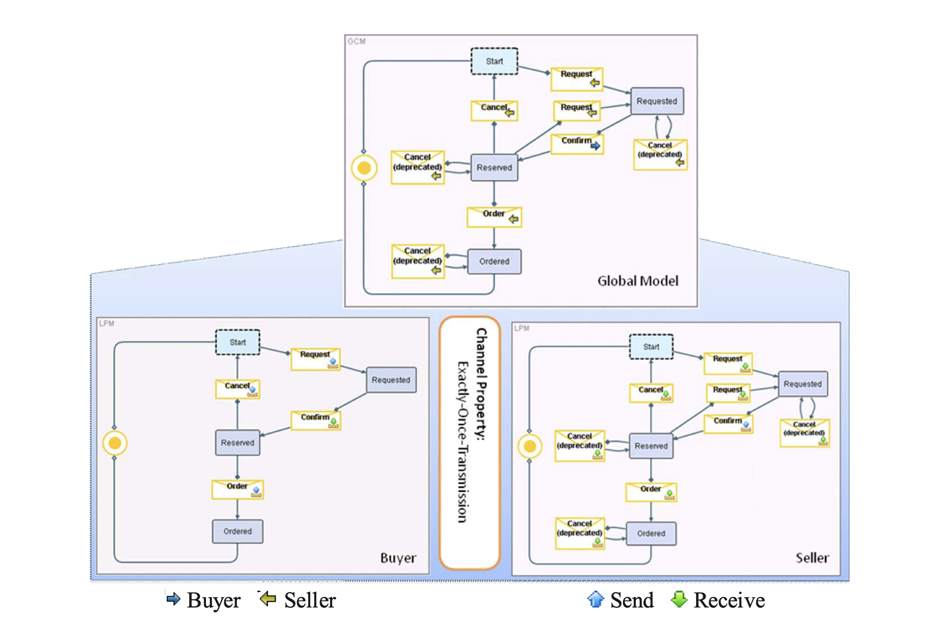
Their example throughout the paper
Top: GCM of the choreography Bottom Left: LPM of the buyer Bottom Right: LPM of the seller

Slide 15
About:
Describes the negotiation process between two service components: a buyer and a seller
The communication involves message exchanges, so the authors assumed the communication channel is reliable but doesn’t preserve messages order; In this regard, they added ID_SET variable that stores unfinished request IDs that ensures there will be no faulty Cancel events called
First, the buyer sends a Request message and awaits for a Confirm message from the seller, then the buyer can Cancel or Order, terminating the process
Limitations of this example:
The assumption of a reliable communication channel (no channel is error-free in reality)
The example matches the pattern of enterprise software, so applying Finite state machine approaches for test generation is not suitable

Slide 16
MCM Syntax

Slide 17
Message Choreography Model (MCM) structure
Assumption: all choreographies consist of two participating components.
MCM = (GCM, LPM₁, LPM₂, CM).
GCM = Global Choreography Model
LPM₁, LPM₂ = Local Partner Models
CM = Channel Model
Global Choreography Model (GCM)
Based on a finite state machine L = (S, I, ⇨).
Any element of the relation ⇨ is a tuple (S’, I, S’’).
The language used for additional guards and actions of the GCM:
Finite set ET (elementary types)
Finite set of labels F
Set T of record types
The set CT (complex types)
The set of set types Set(t)

Slide 18
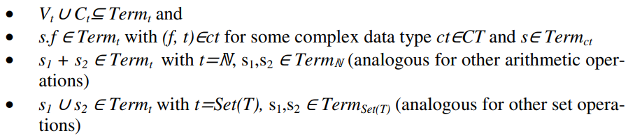
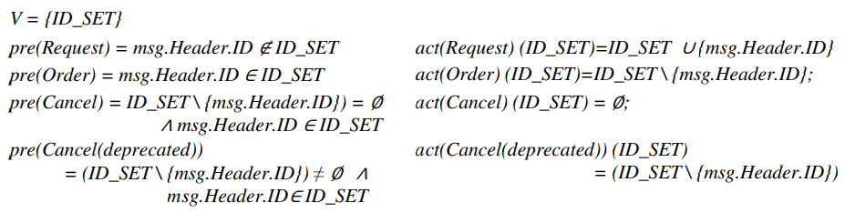
The set Term_{t} - definition
GCM is a tuple GCM = (L, V, C, itype, pre, act).

Slide 19
Local Partner Models (LPM)
Obtained from the GCM by duplicating the states and global variables for each of them.
Each i ∈ I is transformed into the corresponding element from PI={send_i, receive_i | for all i ∈ I}.
Additionally, can be extended with an inhibitor function inhib.
Example:
Interaction Request in GCM -> send_Request in LPM₁ and receive_Request in LPM₂.
pre(send_Request) = msg_1.Header.ID ∉ ID_SET1
act(send_Request) (ID_SET1) = ID_SET1 ∪ {msg.Header.ID}
Channel Model (CM)
Formal representation of the communication behaviour between the two components.
Reliability guarantees can be modeled:
exactly once in order (EOIO) where π_{IT’}(CM) is the identity function on interaction sequences
exactly once (EO) where π_{IT’}(CM) is a permutation on an interaction sequence.

Slide 20
Translating
MCM to Event-B

Slide 21
Event-B
Evolution of the B-Method - static (context) and dynamic properties (so-called machine).
Variables form the state of the machine whilst events describe transitions from one state into another.
EVENT ≙ ANY t WHERE G(t,x) THEN S(x,t) END.
G = predicate (guard).
S(x, t) = substitution.
Design Considerations of Translation
The two LPMs are necessary to map the generated test cases to local test case.
Unique natural number is needed because of messages with the same type and content may occur more than once.
The authors aim to use a model checking technique so that the translation result is as deterministic as possible.

Slide 22
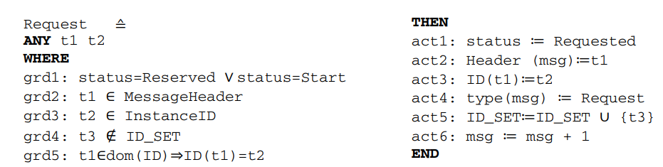
Translation Description
Global Model:
For each transition in the GCM, there is exactly one event generated.
i ≙ WHEN guard1: status=s1 ∨ … ∨ status=sk THEN act1: status ≔ sm END,
status = global variable with elements from the constants set {s1,…,sk}.
Data types, constants, variables, terms and formulae are needed in order to have preconditions and actions associated with an interaction.

Slide 23
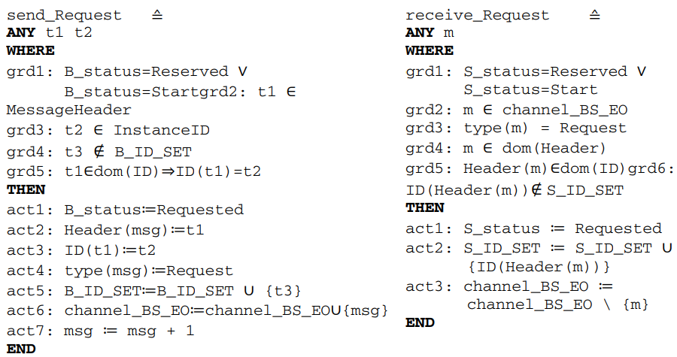
Translation Description
Local Model:
Events represent sending or receiving messages depending on the viewpoint.
Duplicated variables and status of the global model for each local model.
Variable msg keeps the unique message enumeration.

Slide 24
Test Generation

Slide 25
ProB
ProB is a validation toolset that allows users to animate and model-check the specification that the modeler intended.
It has been adapted to support formalisms such as Z, CSP and CSP||B.
The test generation algorithm consists of three steps.
Generation of the Initial Global Test Suite
Mapping of Global to Local Paths.
Test Suite Reduction
Step 1: Generation of the Initial Global Test Suite
The goal is to cover each transition of the global communication model.
In the authors’ example, the state space is actually infinite, so in order for it to be reduced, the authors configure ProB to compute only a few possible ways to enable any event.
ProB has to detect when full transition coverage is obtained.
The need for the history variable.

Slide 26
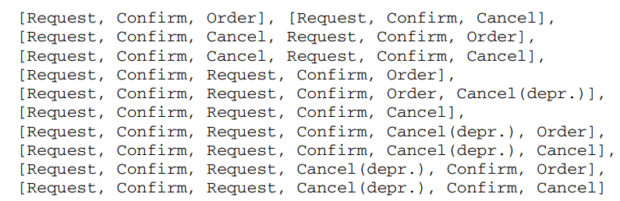
Initial test suites obtained from this paper:

Slide 27
Step 2: Mapping of Global to Local Paths
Path used as example:
[Request, Confirm, Request, Confirm, Cancel(depr.), Cancel]
Translation to sequences of receive events (? reads “receives”)
[Seller?Request, Buyer?Confirm, Seller?Request, Buyer?Confirm,
Seller?Cancel(depr.), Seller?Cancel]
For each receive event a corresponding send event is generated and added to the path:
[Buyer!Request, Seller?Request, Seller!Confirm, Buyer?Confirm,
Buyer!Cancel, Buyer!Request, Seller?Request, Seller!Confirm,
Buyer?Confirm, Seller?Cancel(depr.), Buyer!Cancel, Seller?Cancel]

Slide 28
Step 2: Mapping of Global to Local Paths
Translation to CSP process:
RECEIVER = Seller?Request -> Buyer?Confirm -> Seller?Request ->
Buyer?Confirm -> Seller?Cancel(depr.) ->
Seller?Cancel -> goal -> STOP
SENDER(n1,n2,n3,n4) = n1>0 & Buyer!Request -> SENDER(n1-1,n2,n3,n4) []
n2>0 & Seller!Confirm -> SENDER(n1,n2-1,n3,n4) []
n3>0 & Buyer!Cancel -> SENDER(n1,n2,n3-1,n4) []
n4>0 & Buyer!Order -> SENDER(n1,n2,n3,n4-1)
MAIN = SENDER(2,2,2,0) ||| RECEIVER

Slide 29
Step 3: Test Suite Reduction
In the first prototypical version, brute force algorithm is used and then the optimal combination of test cases is selected according to the objectives.
[Request, Confirm, Request, Cancel(depr.), Confirm, Order],
[Request, Confirm, Request, Confirm, Cancel(depr.), Cancel],
[Request, Confirm, Request, Confirm, Order, Cancel(depr.)]
Better approach:
Identify global interactions that can only be covered by paths incorporating message racing (in our example: the three interactions Cancel(deprecated).
For these, a minimal set of covering paths is determined using a greedy algorithm.
If there are more possibilities, it is chosen the one that has the highest overall interaction coverage.
The resulting test suite is filled with the minimum set of paths (not incorporating message racing) that covers the remaining interactions.

Slide 30
Demo

Slide 31
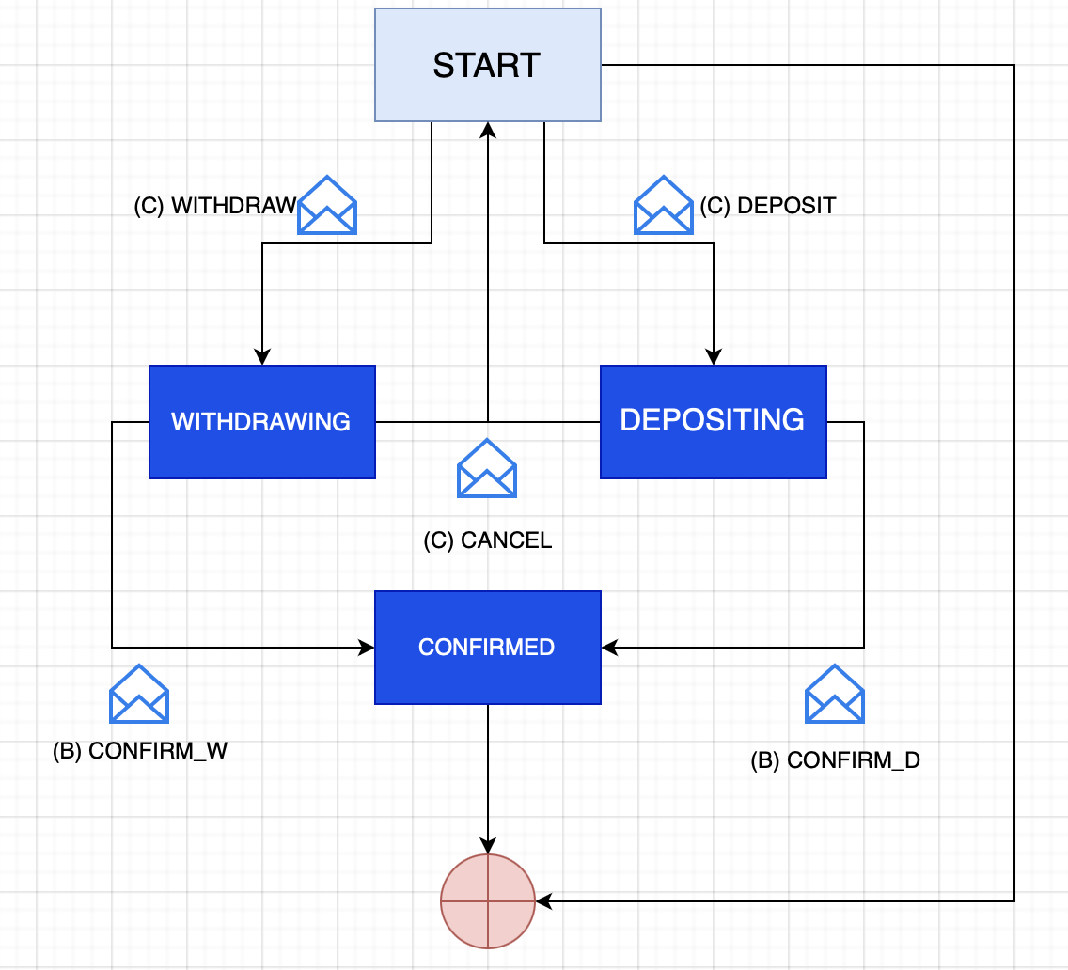
Our model
We’ll be designing a mini banking system
The logic is:
A client can Withdraw or Deposit an amount from or to a bank
A bank can Accept or Decline a client’s transaction
The bank will wait for a client to initiate a transaction before having enabled actions
A client can Cancel a started transaction
Messages travel through a reliable channel
GCM
C = Client B = Bank

Slide 32
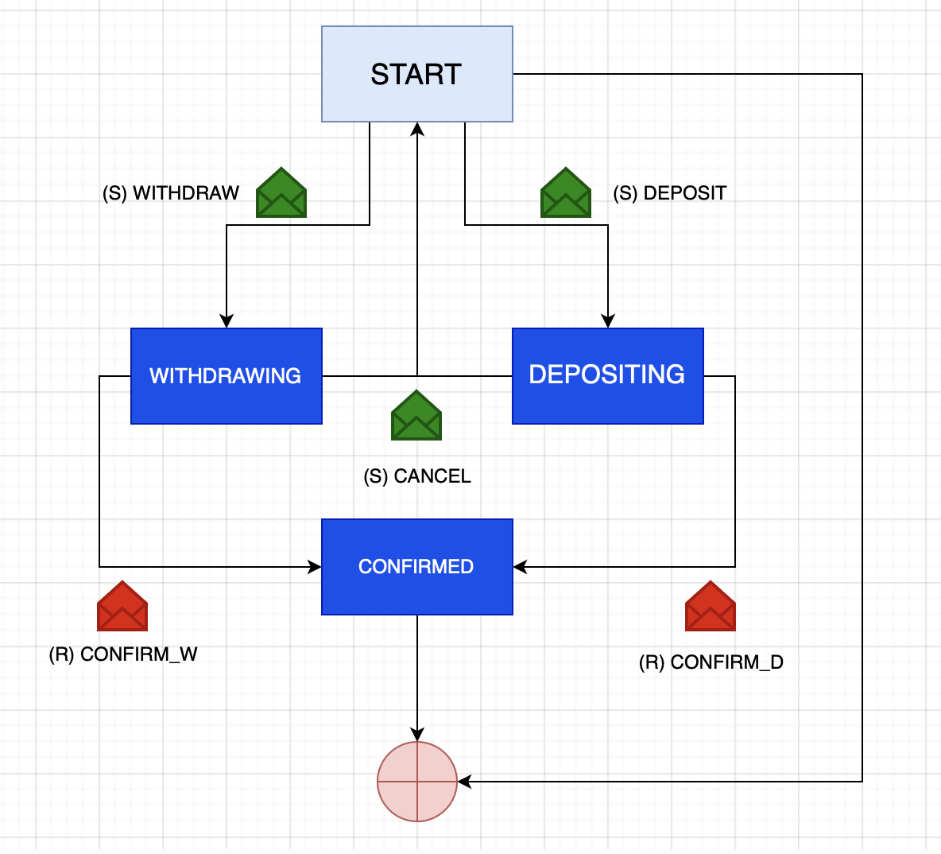
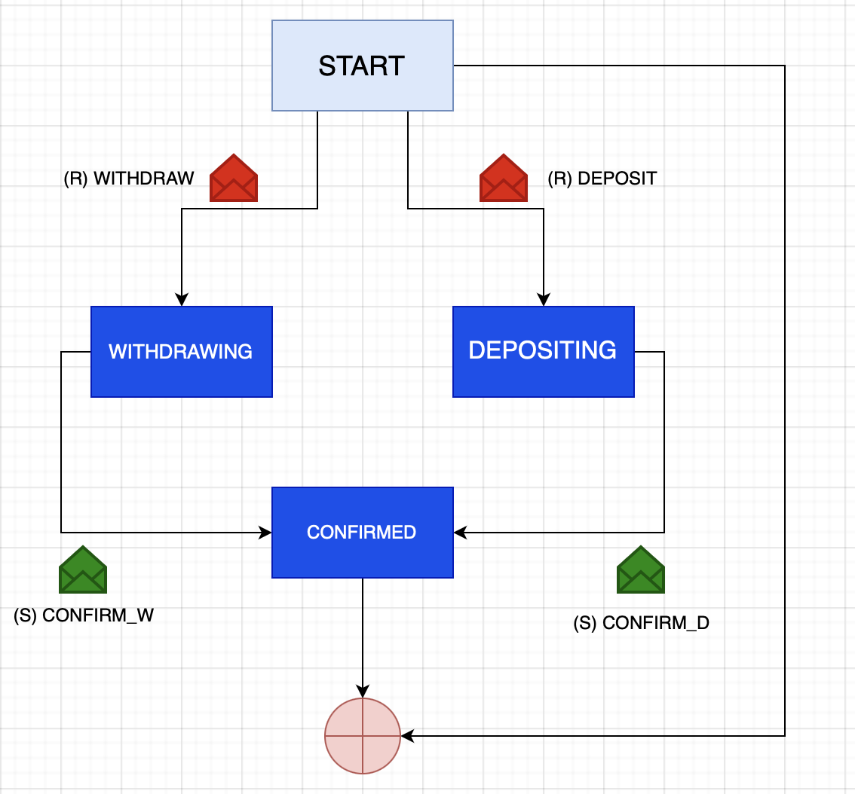
Client LPM Bank LPM
S = SEND R = RECEIVE

Slide 33
Conclusion

Slide 34
In this paper, the authors presented an approach to generate test suites for service choreographies using model checking.
They used MCM models and translated them to Event-B models for ProB, a model checker used for test generation. They also extended ProB to detect transition coverage and utilized CSP process to guide the Event-B model. The resulting test suite was generated automatically and designed to cause minimal effort during test concretization and execution.
The approach is a contribution to the research community by incorporating message racing and avoiding state explosion.

Slide 35
Resources
Wieczorek, S., Kozyura, V., Roth, A., Leuschel, M., Bendisposto, J., Plagge, D., Schieferdecker, I.: Applying Model Checking to Generate Model-Based Integration Tests from Choreography Models

